Slide 1
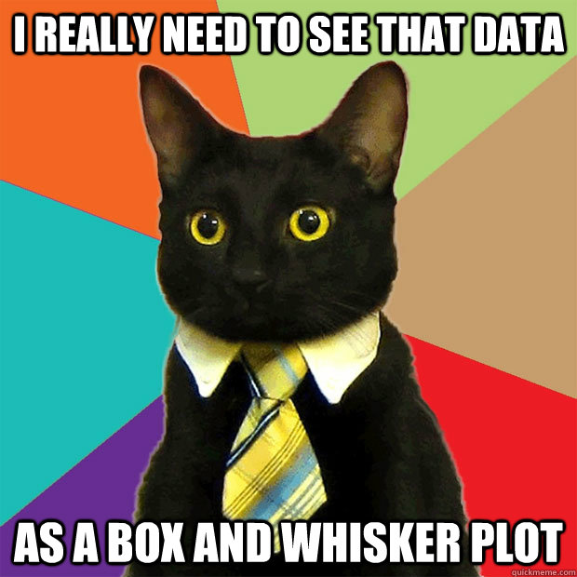
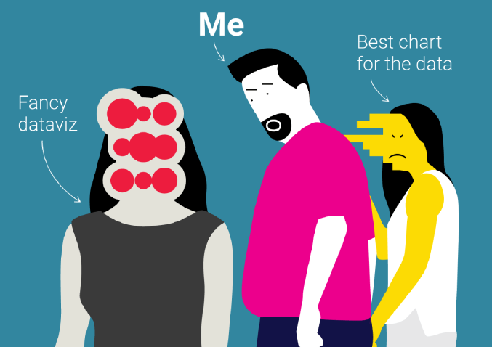
Data Visualization 2
More descriptive plots

Slide 2
Topics
Introduction: GUI and basic calculations
Coding 1: Scripts, style, and variable classes
Coding 2: Control statements and loops
Visualization 1: Basics, subplots, get and set
Coding 3: Functions
Visualization 2: Descriptive plots
Coding 4: Basic input and output
Visualization 3: Distribution and 3D plots
Coding 5: Input and output specials – last lecture before holidays
Machine Learning 1: Introduction and dimension reduction
Machine Learning 2: Clustering
Machine Learning 3: Classification
Coding 6: Efficiency and debugging basics
Coding 7: Advanced functions and debugging

Slide 3

Legends and Annotations
Legends are necessary if multiple lines are in one plot
Legends can easily be created in MATLAB
Function „legend“
You can also use plot handles to only make legends for specific lines
You can chose font, location and other things of the legend box in your plot
A text and annotation can be displayed in a fig with these functions, respectively
Annnotations can be arrows, rectangles, textboxes, … positions, fontsize, color etc. can be changed

Slide 4
Two axes in one
It‘s possible to plot two axes in one using yyaxis left/right or plotyy
The plot color by default is set to the color of the axis (orange/blue)
Change like this:
left_color = [R,G,B]; right_color = [R,G,B];
R,G,B in the range [0,1]
“set(gcf,'defaultAxesColorOrder',[left_color; right_color]);”
Very handy when it comes to differently scaled data that should be shown in one plot for comparison

Slide 5
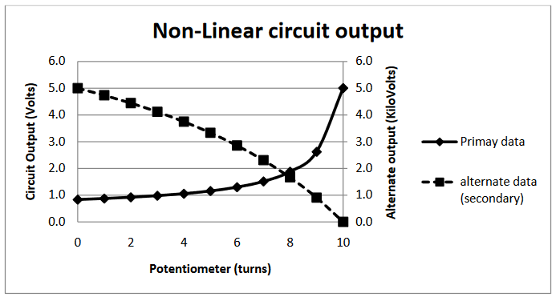
Two axes in one

Slide 6
More plot functions
Scatter plots to display discrete markers only
Descriptive statistics:
Barplots (with errorbar)
Boxplot
Histogram
Important to understand the differences
Choose the plot that suits your data!
Bar plots not for means, but for quanitities

